Slide 1

COST EFFECTIVENESS AND CLINICAL EFFECTIVENESS OF CARBETOCIN VS OXYTOCIN IN POSTPARTUM HEMORRHAGE
Emma Pugh
Aparajitha Pampana
Jyothsna Ravipalli
Uma Maheswari

Slide 2


AGENDA
Introduction
Background and Rationale
Research Question
Hypothesis
Population & Study Time
Methods
Design, Input, EndPoints
Statistical Analysis Plan
Results
Limitation
Conclusion
References

Slide 3
POST PARTUM HEMORRHAGE- AN OVERVIEW
•Postpartum haemorrhage (PPH) has historically been defined as expected blood loss from vaginal delivery of more than 500 mL or from caesarean delivery of more than 1000 ml.
•The definition was redefined in 2017 by the American College of Obstetrics and Gynaecology, and it now includes cumulative blood loss over 1000 mL and hypovolemia symptoms and signs within 24 hours of giving birth, irrespective of delivery method.

Slide 4

BACKGROUND
•Cause of pregnancy related death varied by race and ethnicity.
•Haemorrhage deaths occured in the postpartum period in high-income nations (49.1%) and low-/middle-income countries (73%).
•1/4rth of maternal deaths worldwide and 12% in the United States.
•Existing treatment : Prostaglandin (Contraindicated in Asthma), Misoprostol (cause Tachycardia), TXA (Equivocal Evidence).
•Novel treatments : Isotonic crystalloids, Uterine massage, Uterine balloon tamponade, Nonpneumatic antishock garment, hypogastric artery ligation.
•Every year, around 14 million women suffer from PPH, which causes approximately 70,000 maternal deaths worldwide.
•3% to 5 % patients experience postpartum hemorrhage yearly.

Slide 5


RATIONALE
OXYTOCIN
If choosing between oxytocin and carbetocin for postpartum hemorrhage, the second drug is less expensive over time because it requires no particular storage and lasts longer
•Half life of 3-5 min
•Synthetically prepared oxytocin should be stored between 2-8 Deg Celsius.
•Side effects: Blurred vision, Uterine hyperstimulation, Fetal heart rate deceleration, Anaphylactic shock, Rupture of Uterus, Brain damage, Death due to suffocation.
•Dose : 0.5 to 1 milliunits/min via IV infusion
CARBETOCIN
•It is approved in 23 countries around the world (not approved in US).
•But it is first line therapy in Canada and Germany.
•Common side effects include vomiting, Fever, hypertension.
•Dose: 100 microgram via IV
•Long-acting synthetic with a half-life 4 to 10 times longer than natural oxytocin.
•Heat-stable carbetocin does not require refrigeration unlike oxytocin.

Slide 6

Is Carbetocin more cost effective / clinically effective than oxytocin for individuals undergoing cesarean delivery or having a vaginal delivery who are at high risk for postpartum hemorrhage ?
RESEARCH QUESTION

Slide 7


HYPOTHESIS
H0:
H1:
The usage of carbetocin for those undergoing cesarean delivery/ vaginal delivery is at a high risk of PPH will be more cost effective and clinically effective than oxytocin.
The usage of Carbetocin for those undergoing cesarean delivery/ vaginal delivery at a high risk of PPH will not be cost effective and clinically effective than Oxytocin.

Slide 8

POPULATION & STUDY TIME
•Includes Singleton Pregnant women
•Design : Triple blind randomized controlled trial.
•Project Duration : 4 Months (Spring Semester)
•Study Population: 350 Participants
•Duration of the study : Between August 2016 and January 2017 and who were 20 years or older, had a gestational age of at least 34 weeks.

Slide 9
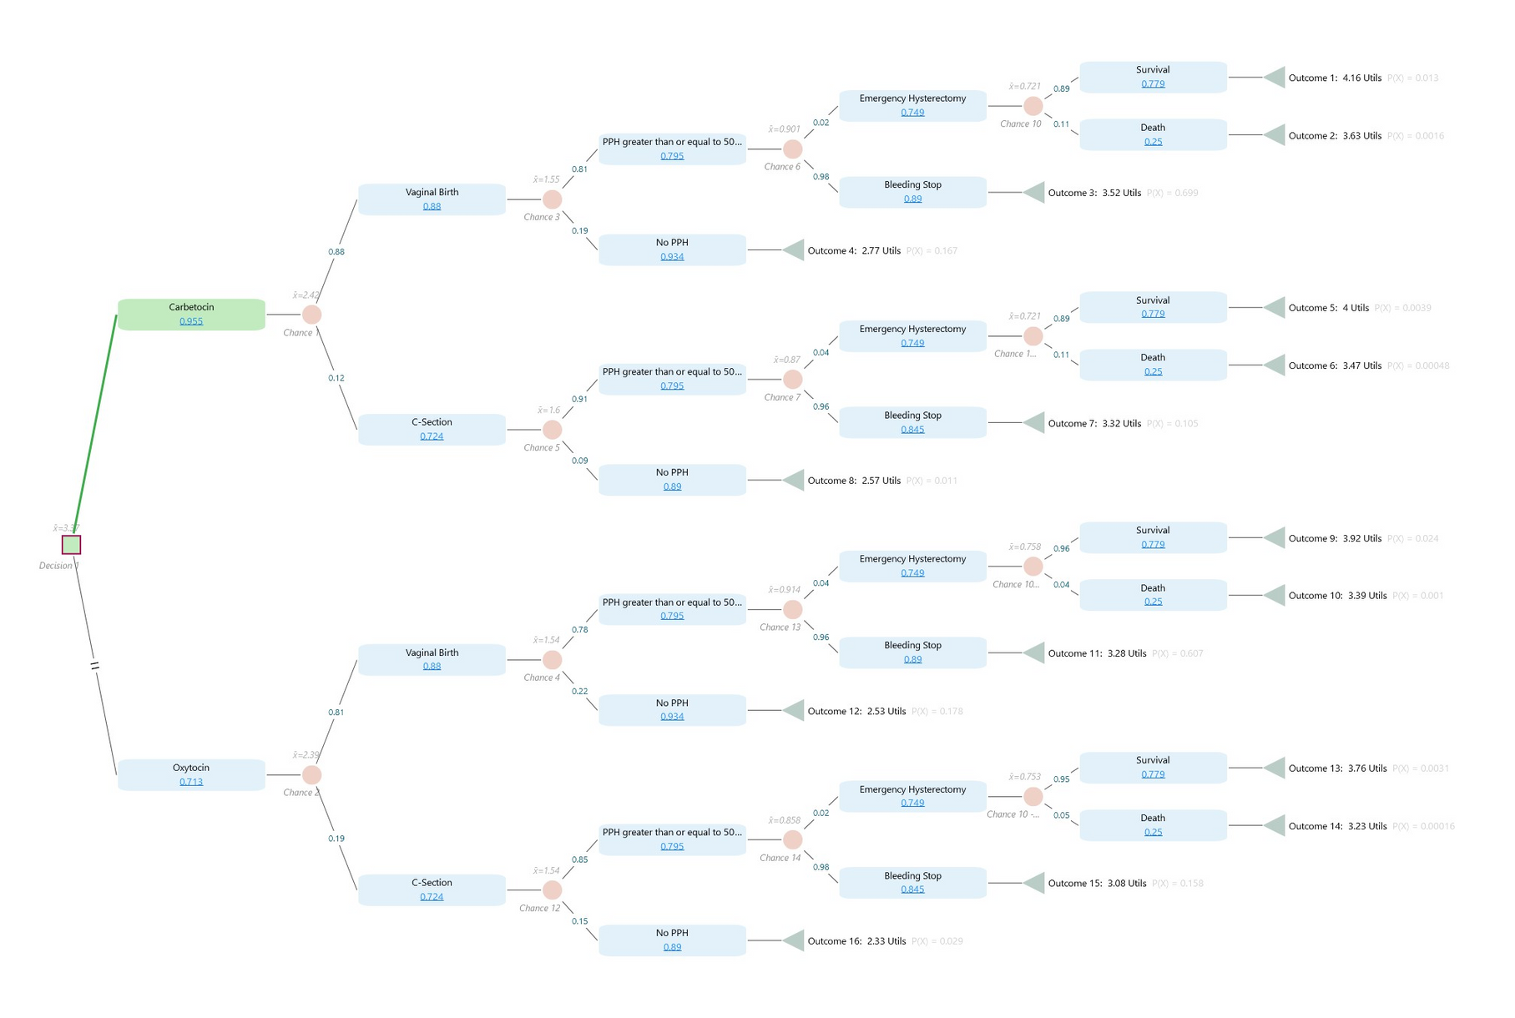
METHOD-DESIGN

Slide 10
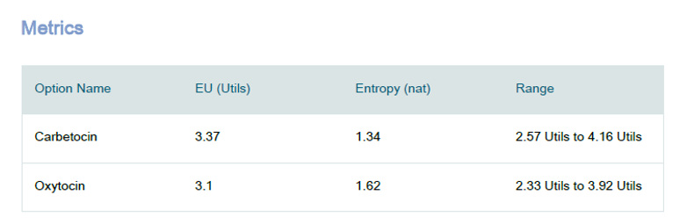
METHOD-OUTPUTS
THE FIGURES SHOW A HIGHER PROBABILITY OF VAGINAL BIRTH WITH THE USE OF BOTH CARBETOCIN AND OXYTOCIN.
THERE'S A HIGH LIKELIHOOD OF PPH WITH BOTH DRUGS, BUT MOST CASES RESULT IN THE BLEEDING STOPPING WITHOUT THE NEED FOR AN EMERGENCY HYSTERECTOMY.
SURVIVAL RATES AFTER SUCH AN EMERGENCY PROCEDURE ARE HIGH, BUT THERE IS A SIGNIFICANT RISK OF DEATH.
UTILITY POINTS SEEM TO BE A MEASURE OF OUTCOME QUALITY OR COST-EFFECTIVENESS, WITH HIGHER POINTS SUGGESTING BETTER OUTCOMES.
Carbetocin appears to have a higher expected utility and a wider range of possible utilities, but with less uncertainty around its outcomes. Oxytocin has a slightly lower expected utility, a higher degree of uncertainty, and a narrower range of possible utilities.

Slide 11
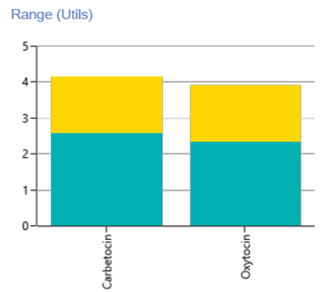
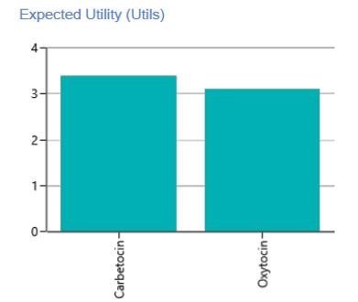
Both Carbetocin and Oxytocin are close in their expected utility
values, with Carbetocin having a slightly higher value.
This graph illustrates the spread of potential utilities for each
option. Both Carbetocin and
Oxytocin have a substantial overlap in utility ranges,
but Carbetocin has a slightly higher potential maximum utility.
METHOD- OUTPUTS:
Benjamin Shah
Phyllis Schwaiger
Chad Gibbons
Doctor
Doctor
Doctor

Slide 12
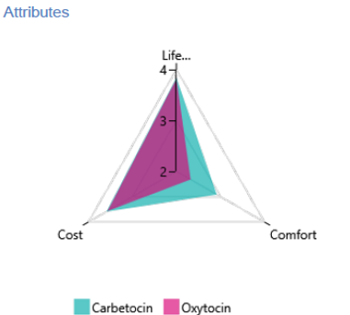
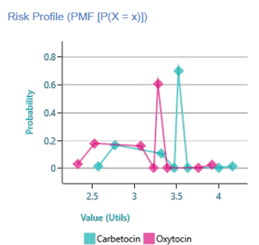
METHOD- OUTPUTS:
Carbetocin shows a peak at a higher utility value than Oxytocin, suggesting a higher likelihood of achieving a greater utility, albeit with some variability. Oxytocin shows a more even distribution with lower peaks, indicating more spread-out probabilities across different utility values.
Compares Carbetocin and Oxytocin on attributes like life-enhancing properties, cost, and comfort. Carbetocin appears to offer more life-enhancing properties and comfort but is perhaps more costly, whereas Oxytocin offers less in these attributes but may be less costly.

Slide 13

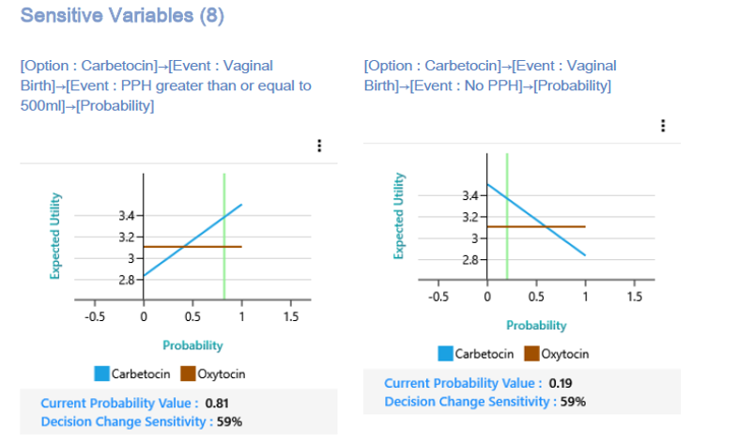
METHOD- OUTPUTS:
Carbetocin is depicted as having a higher probability of favorable outcomes (such as lower risk of PPH and higher comfort levels) with a substantial impact on expected utility. Oxytocin has a much lower probability of these favorable outcomes, significantly affecting its expected utility. Both drugs are sensitive to changes in these probabilities, meaning that shifts in the likelihood of these events could significantly impact the decision to use one over the other.

Slide 14
LIMITATIONS
Decision-analytical modeling is naturally unpredictable in terms of input parameters. To reduce this uncertainty, clinical inputs for the model were gathered from both worldwide and local clinical studies.
The model structure was developed in a brief period of time (postpartum hospitalization) and did not completely take into consideration the long-term consequences.
Adding transition states in Markov’s model.

Slide 15
CONCLUSION
The decision analysis report provides a detailed and methodologically sound framework for comparing the effectiveness of Carbetocin and Oxytocin in the management of postpartum hemorrhage (PPH).
The application of a multi-criteria utility function, which balances factors such as life expectancy, comfort, and cost, facilitates a comprehensive approach to maximizing expected utility in patient care.
The findings suggest that Carbetocin may be preferable in specific contexts, particularly where the goal is to minimize the incidence and severity of PPH. This conclusion is bolstered by the stochastic dominance of Carbetocin in several modeled scenarios, indicating its potential for better overall outcomes compared to Oxytocin

Slide 16
REFERENCES
Wormer, K. C., Jamil, R. T., & Bryant, S. B. (n.d.). Acute postpartum hemorrhage - statpearls - NCBI bookshelf. National Center for Biotechnology information. https://www.ncbi.nlm.nih.gov/books/NBK499988/
Khan, K. S., Pritchard, J. A., Kominiarek, M. A., Baskett, T. F., Villar, J., Surbek, D. V., Bamigboye, A. A., O’Brien, P., O’Leary, J. L., Hebisch, G., Philippe, H. J., Baggish, M. S., AbdRabbo, S. A., Zelop, C. M., Kastner, E. S., Kwee, A., Lau, W. C., O’Leary, J. A. (2007, October 5). Postpartum hemorrhage. Obstetrics and Gynecology Clinics of North America. https://www.sciencedirect.com/science/article/abs/pii/S0889854507000587
Jin, X.-H., Li, D., & Li, X. (2019). Carbetocin vs oxytocin for prevention of postpartum hemorrhage after vaginal delivery. Medicine, 98(47). https://doi.org/10.1097/md.0000000000017911
Larciprete G;Montagnoli C;Frigo M;Panetta V;Todde C;Zuppani B;Centonze C;Bompiani A;Malandrenis I;Cirese A;Valensise H; (n.d.). Carbetocin versus oxytocin in caesarean section with high risk of post-partum haemorrhage. Journal of prenatal medicine. https://pubmed.ncbi.nlm.nih.gov/23741542/
Tse, K., Yu, F. N., & Leung, K. (2020). Comparison of carbetocin and oxytocin infusions in reducing the requirement for additional uterotonics or procedures in women at increased risk of postpartum haemorrhage after caesarean section. Hong Kong Medical Journal. https://doi.org/10.12809/hkmj208683
Ai, W., Zeng, Y., Ma, Y., Liu, L., Fan, D., Wu, S., & Zhang, Y. (2021). Side‐effects of carbetocin to prevent postpartum hemorrhage: A systematic review and meta‐analysis of Randomized Controlled Trials. Pharmacology Research &amp; Perspectives, 9(2). https://doi.org/10.1002/prp2.745
Liu, C., Yu, F., Xu, Y., Li, J., Guan, Z., Sun, M., Liu, C., He, F., & Chen, D. (2021, April 26). Prevalence and risk factors of severe postpartum hemorrhage: A retrospective cohort study - BMC pregnancy and childbirth. BioMed Central. https://bmcpregnancychildbirth.biomedcentral.com/articles/10.1186/s12884-021-03818-1

Slide 17
REFERENCES
Evensen, A., Anderson, J. M., & Fontaine, P. (2017, April 1). Postpartum hemorrhage: Prevention and treatment. American Family Physician. https://www.aafp.org/pubs/afp/issues/2017/0401/p442.html#:~:text=Approximately%203%25%20to%205%25%20of%20obstetric%20patients%20will,to%2024%20hours%20after%20delivery%20of%20the%20fetus
Briones, J. R., Talungchit, P., Thavorncharoensap, M., & Chaikledkaew, U. (2020a, October 26). Economic evaluation of carbetocin as prophylaxis for postpartum hemorrhage in the Philippines - BMC health services research. BioMed Central. https://bmchealthservres.biomedcentral.com/articles/10.1186/s12913-020-05834-x
Cook, J. R., Saxena, K., Taylor, C., & Jacobs, J. L. (2023, March 17). Cost-effectiveness and budget impact of heat-stable carbetocin compared to oxytocin and misoprostol for the prevention of postpartum hemorrhage (PPH) in women giving birth in India - BMC Health Services Research. BioMed Central. https://bmchealthservres.biomedcentral.com/articles/10.1186/s12913-023-09263-4#:~:text=Heat-stable%20carbetocin%2C%20as%20a%20prophylactic%20alternative%2C%20continued%20to,depending%20on%20the%20source%20of%20costs.%20More%20items
You, J. H. S., & Leung, T. (2022, December 15). Cost-effectiveness analysis of carbetocin for prevention of postpartum hemorrhage in a low-burden high-resource city of China. PloS one. https://pubmed.ncbi.nlm.nih.gov/36520799/
Gallos, I. (2019, February). Uterotonic drugs to prevent postpartum haemorrhage: A network meta-analysis. National Center for Biotechnology Information. https://www.ncbi.nlm.nih.gov/books/NBK537861/

